Slide 1
PRODUCT ROADMAP
Cloud
WAF
Last update: March 2020

Slide 2
Disclaimer
This presentation is being provided for INFORMATIONAL PURPOSES ONLY. The information provided represents Imperva’s expectations as of the date the presentation was prepared. Imperva undertakes no obligation to update or revise this information. The information should not be construed as a commitment to deliver any specific upgrade or feature or functionality.
Imperva may change the contents of the presentation in its sole discretion at any time. You should not rely on the anticipated timelines or potential upgrades, features or functionality described in the presentation when making a decision to purchase products from Imperva.

Slide 3
Imperva Cloud WAF Secures at the Edge so the Traffic You Receive is only the Traffic You Want.
Core Capabilities in a Single Stack
Security
Performance & Availability
Insights and Analytics
Bad Bot
User
Hacker
Web Apps and APIs
3
Notes:
Imperva Cloud WAF is a part of Imperva’s Cloud Application Security Suite. At Imperva, our SaaS-based WAF is part of an an overall edge platform, architected into a single cloud application security and delivery stack. With it, we provide the best website protection in the industry. It’s PCI-compliant, automated security that goes beyond OWASP Top 10 coverage, with the comprehensiveness to reduce the risks that using third party code creates, plus integrated analytics.
Our WAF provides always on protection, allowing you to focus on just the most critical security incidents, without getting bogged down by a lot of manual work that a WAF relying on opensource security creates. Imperva WAF also integrates into the DevOps processes in order to have security enable the business, with automatic policy creation and fast rule propagation. And while you can never fully eliminate risk, you can minimize it by mitigating 3rd party vulnerabilities automatically, with a managed service that provides out of the box protection backed by a team that stays up to date on all of the latest security threats.

Slide 4
Imperva
protects data
and all paths to it
Notes:
Data is what matters. Our mission in Imperva is to protect your data, regardless of how it is accessed and who accesses it. Whether it’s Applications or APIs, we are there to keep your data safe

Slide 5
The Imperva Products Portfolio
CDN
DDoS
RASP
WAF GW
Desktop
Applications
Mobile Devices
Network
Microservices
APIs
Data
Partners
Bot
Cloud WAF
WAF GW
CDS
DAM
DRA
Bots
Notes:
And this is how we do it - describe the portfolio

Slide 6
Cloud WAF
CDN
DDoS
RASP
WAF GW
Desktop
Applications
Mobile Devices
Network
Microservices
APIs
Data
Partners
Cloud WAF
CDS
DAM
DRA
Bots

Slide 7
Cloud WAF Latest Additions
Security & Automation
Near rule parity - 60+ new filters and custom rate rules
TLS 1.3
TerraForm provider
API v2 initiative
Enhanced password policy
Enhanced hashed masking
Management & Integration
SSO integration to Imperva console
Role management
Audit Trail
Custom error page design
Central management of SIEM logs for enterprises
New SIEM integrations
API Security & Open Banking
Positive security model
Swagger 2 support
CI/CD integration with APIs
Integration with Attack Analytics
Integration with API Management systems
Error page response with XML and JSON
Certificate Revocation List for client certificates
Notes:
In the past few months we focused on three themes:
Security and automation - enhancing our security offering and allowing customers to integrate the security into their DevOps processes. This theme includes addition of over 60 new custom filters and rate rules to allow customers to optimize their security, TLS 1.3 and enhanced has masking to provide stronger security, as well as a TerraForm provider to allow integration with DevOps processes and a long-term initiative to adjust the format of our APIs to a better ReST standard
Management and Integration with external systems - added features to enhance the enterprise experience, including SSO support for Imperva’s Management poral, Role Management, Audit Trail, integration packages for new SIEMs etc.
API Security and Open Banking compliance - added API Security capabilities, such as a positive security model, to mitigate new vulnerabilities related to the expanded use of APIs, and other features to support the Open Banking initiative in AU

Slide 8
Cloud WAF Looking Forward
Customers experience | SSL Renewal Automation | Supportability Features (self management, automation) | Supportability Features (self management, automation)
 | Infrastructure Robustness | Infrastructure Robustness | Infrastructure Robustness | Infrastructure Robustness
Security |  | Integration with Distil | HSM Support | Adaptive DDoS Policy
 |  | HTTP/2 End-to-End
Management & Visibility |  | Policy Management |  | Role and Permission Granularity
 |  | Terraform Provider Enhancements |  | Improved SIEM Integration
API Security |  | Embed API Security Into Cloud WAF |  | API Discovery
 | Q1 | Q2 | +6 months
Notes:
In the next 12 month, we are going to focus on 4 themes.
Customer experience - add automation, self-service and self-troubleshooting features to spare the need of calling support team and allow Imperva’s Support to provide quicker responses
Security - enhance the customer’s security with HTTP/2 end2end support, integration with HSM, an improved adaptive DDoS policy that will automatically adjust the L7 DDoS threashold, and integration with Distil to provide Advanced Bot Protection for Cloud WAF customers
Management and visibility - better enterprise experience for customers, including Policy Management, which allows using policies to manage a large number of sites, enhancements to the TerraForm provider and to the granularity of roles, and improved experience for SIEM integration - near realtime logs and simplified integration process
API Security - add API Security as an integrated feature of Cloud WAF and provide API Discovery capabilities - discover API end-points structure without having a Swagger file

Slide 9
SSL Renewal Automation
Automatic
Automatic process for renewing Imperva-generated certificates
When the customer’s involvement is needed, automatic emails are sent with an exact explanation and instructions
Reliable
Begins 3 months before renewal is needed
Quick
Validation cycle is shortened to a few hours
SSL
Notes:
When Imperva initiated certificates have to be renewed, we want to do it reliably, on time, and with minimal involvement from the customer.
This feature automates today’s manual process. It will automatically begin 3 months before the certificate expiry date, and the customer will be informed about the process via email. When a customer is required to perform an action - i.e. to add a txt validation file in the DNS - a clear notification will be sent with detailed instructions. When this happens, the validation will be done within a few hours.

Slide 10
Supportability Features
Self Management
Add more self-management and self-troubleshooting tools for customers
Shorten Support Cycles
Automate support processes to make more resources available
Add tools to provide more information to support teams, to shorten support cycles
Notes:
As a part of the effort to improve the customers’ support experience, we are mapping the system and adding new options for self-management and troubleshooting for customers, as well as automation and tools for support to shorten support cycles.

Slide 11
Infrastructure Robustness
More Customers
Increasing Traffic
Improved Scalability
Notes:
As Imperva continues to grow, the number of customers increases every month, as well as the traffic that flows through our cloud. We are committed to providing best quality service, and we are investing continuously throughout the year to make sure our systems are scalable and robust enough to meet the growing needs.

Slide 12
Integration With Distil
Fully integrated into
the Imperva Cloud
AppSec
Notes:
Following the acquisition of Distring Networks last year, we are now integrating Distil will Cloud WAF, to allow customers to enjoy the advanced technology of the Advanced Bot Protection service

Slide 13
HTTP/2 End-To-End
HTTP/2 End-To-End
gRPC Support
User
Web Apps and APIs
Notes:
Cloud WAF supports the HTTP/2 protocol from the end-user to WAF, and the traffic from WAF to the origin server is downgraded to HTTP/1.1 or 1.0.
We are expanding our support to allow using HTTP/2 end-to-end, all the way from the end-user, through WAF, to the origin server. We are also adding support for gRPC over HTTP/2.
This will allow customers to enjoy the performance enhancements of HTTP/2 and remain protected when using gRPC and Protobuf in their applications.

Slide 14
HSM Support
Control Your Secrets
Integration with on-prem NetHSM
Integration with HSM systems, controlled by the customer
Integration with Public Cloud HSMs
SSL keys never leave the customer’s control
Notes:
When a customer uploads a custom SSL certificate to Cloud WAF, the certificate is encrypted and stored securely on the local file system. Highly regulated customers, however, such as banks and financial organization, require more control and better security for their SSL certificates.
To allow better security and control, we are going to allow customer to store their certificates in their HSMs. We will integrate with on-prem HSMs through the NetHSM protocol, and also with Public Clouds’ HSM-as-a-service. The The HSMs will be controlled solely by the customers, which will allow them to maintain full control of their SSL Certificates.

Slide 15
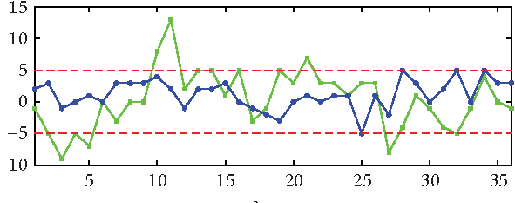
Adaptive DDoS Policy
Adaptive Learning Model
Continuously analyze traffic patterns and clustering by days and hours
Automatic
Automatically adjust L7 DDoS policy based on the model
Hands Free
No need to optimize DDoS threshold by RPS
Notes:
As a part of Cloud WAF, Imperva offers L7 DDoS protection. This service uses a threshold to determine when it starts analysing traffic for suspected DDoS attacks. Many customers, however, are not familiar with their system performance in peacetime and therefore set the threshold to sub-optimal value.
The new Adaptive DDoS Policy will use an automatic adaptive learning model, which will continuously analyze traffic patterns and and adjust the L7 DDoS threshold automatically. Customers will no longer need to set the threshold by RPS, but they will be able to inform the system when irregular traffic volumes are expected, e.g. before a large marketing campaign etc.

Slide 16
Policy Management
Central Configuration
Manage hundreds of sites that require the same configuration from a single location
Dynamic
Multiple policies can be defined to allow flexibility
Easy Site On-Boarding
Default policies can be set to ensure new sites get the right security and configuration out of the box
Policies
Default
Accounts & Sub-Accounts
Apply To
Sites
Notes:
Large enterprise customers are usually characterized by a large estate, sometimes with hundreds of sites.
In many cases, most of the sites require the same configuration.
Configuring each site separately is cumbersome and error prone, an also does not align with DevOps processes, for example for automatic on-boarding.
The Policy Management feature will allow customers to defined policies, and then assign them to multiple sites. Policies can also be set as default on accounts or sub accounts, to make sure new sites added under these sub accounts get the right settings immediately - thus making the site on-boarding much simpler.

Slide 17
Terraform Provider Enhancements
Extended API Coverage
Additional Use Cases
Notes:
A Terraform provider for Imperva’s API was released last year. This year we will add coverage for additional use case and functionality requested by customers.

Slide 18
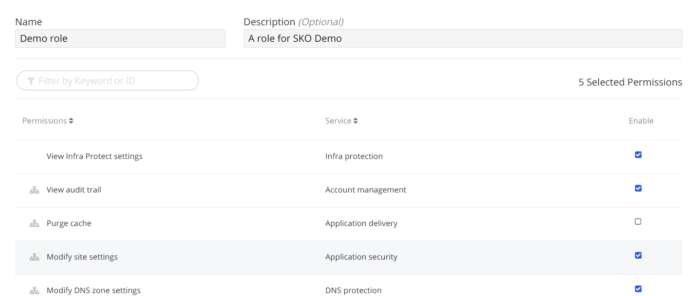
Role & Permission Granularity
Extending Permission Granularity
Role Management was added to Imperva’s Cloud WAF Management Portal in the beginning of 2020
Imperva collects customer requirements for better permission granularity
All feature requests will be implemented during the year
Notes:
Imperva released the Role Management feature in the beginning of this year, which allows customers to define roles and manage permission easily. This year, we are adding granularity of permissions and allowing more flexibility when defining roles. We are collecting requirements from customers and will add granularity based on these requests.

Slide 19
Improved SIEM Integration
Real Time Logs
Logs will be sent to SIEM with a sub-minute delay
Integration At A Click
Integration with SIEMs via syslog or HTTP Streaming
Notes:
SIEM logs are currently sent within up to 30 minutes. To allow using SIEM for real time inspection, we are changing the mechanism to provide near-real-time logs, with a sub-minute delay.
In addition to that we are improving the SIEM integration procedure. Instead of requiring an external script to pull the logs, the integration will be as simple as clicking a button, using syslog or HTTP streaming
This feature is defined as best-effort for this year, and may be postponed to H1 2021.

Slide 20
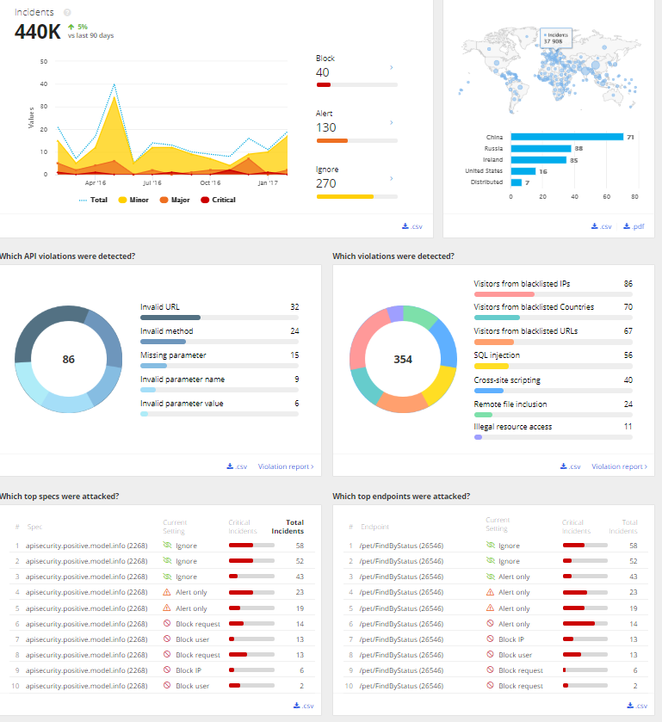
Embed API Security Into Cloud WAF
A Part Of Cloud WAF
API Security will be embedded into Cloud WAF
Mutual dashboards and view
Management as a part of the site
A Part Of On-Boarding
Define the site’s API as a part of the site on-boarding process
Notes:
APIs usage is rapidly increasing in organizations, with mobile applications, initiatives such as Open Banking and more. As a result, APIs exploits are getting more and more common.
Imperva released API Security last year, providing a positive security model and integration with API Management tools. Since we believe that API Security is an integral part of Cloud WAF, we are now embedding API Security view, dashboard and management into the Cloud WAF Management Portal. In addition to that, adding APIs to a site will be done as a part of the site on-boarding process.

Slide 21
API Discovery
Automatic Learning
Learning mechanism to create an API profile or a traffic-based Swagger file
Positive security model even for applications that don’t have a Swagger file
Risk Analysis
Identify the risk for each API end-point
Provide visibility to data leaks
Assist in decision making
Notes:
Imperva’s API Security positive security model is based on a Swagger file that is uploaded by the customer. Some customers, however, do not have Swagger files created as a part of the development process.
For these customers, we are adding API Discovery, to take API Security to the next level. With API discovery, the system will automatically learn the API Structure and format and create a profile that can be used for the positive security model.
In addition to that, the discovery process will also learn the data returned by APIs, and determine the risk level for each API end-point. With this process, you will gain visibility to potential data leaks and be able to make more educated decisions regarding API protection.

Slide 22
Roadmap Recap
Customer
Experience
Security
Management & Visibility
API
Security

Slide 23
Thank You!

